Slide 1


PES Institute of Technology and Management (Afflicted to Visveswaraya Technological University) Presentation on “Wearable Assistive Device for the Blind” By
Priya K C Gadade [4PM19CS070] Sinchana A M [4PM19CS089] Sneha Manjunath [4PM19CS090] Sohan D A [4PM19CS091]
Guide: Ms. Suchitra H L Prof. Dept of CS & E PESITM
Coordinator: Dr. Chethan L S Assoc. Prof. Dept of CS & E PESITM
HoD:
Dr. Arjun U
Assoc. Prof and Head of CS & E
PESITM

Slide 2
CONTENTS
Abstract
Introduction
Literature Survey
Problem Statement
Methodology
Results
Conclusion
References

Slide 3
ABSTRACT
In recent times, several technical systems have been developed to assist the visually impaired. One such system is Braille, which can be quite expensive to print. To address this issue, a wearable assistive device has been created, which can convert text into acoustic output, enabling the user to read any form of text. This device uses a Raspberry Pi based system with camera to assist the visually impaired in reading textual data. The device also includes an LDR sensor that detects the ambient light conditions and turns on the light accordingly. Additionally, the system uses a novel methodology to extract the word pointed by the finger and convert it to audio output using an OCR engine and a TTS converter.

Slide 4
INTRODUCTION
Image Processing
Image processing is a way to convert an image to a digital aspect and perform certain functions on it, in order to get an enhanced image or extract other useful information from it. It is a type of signal time when the input is an image, such as a video frame or image and output can be an image or features associated with that image.

Slide 5
AI Enabled IoT
IoT is about sensors implanted into machines, which offer streams of data through internet connectivity. All IoT related services inevitably follow five basic steps called create, communicate, aggregate, analyse, and act.
While IoT provides data, artificial intelligence acquires the power to unlock responses, offering both creativity and context to drive smart actions. As the data delivered from the sensor can be analyzed with AI, businesses can make informed decisions.
Text to speech
eSpeak is a compact open source software speech synthesizer for English and other languages, and is used to convert the text file to audio output which is heard via an audio output device such as earphones. Python 3 wrapper for eSpeak is utilized to implement the algorithm.

Slide 6
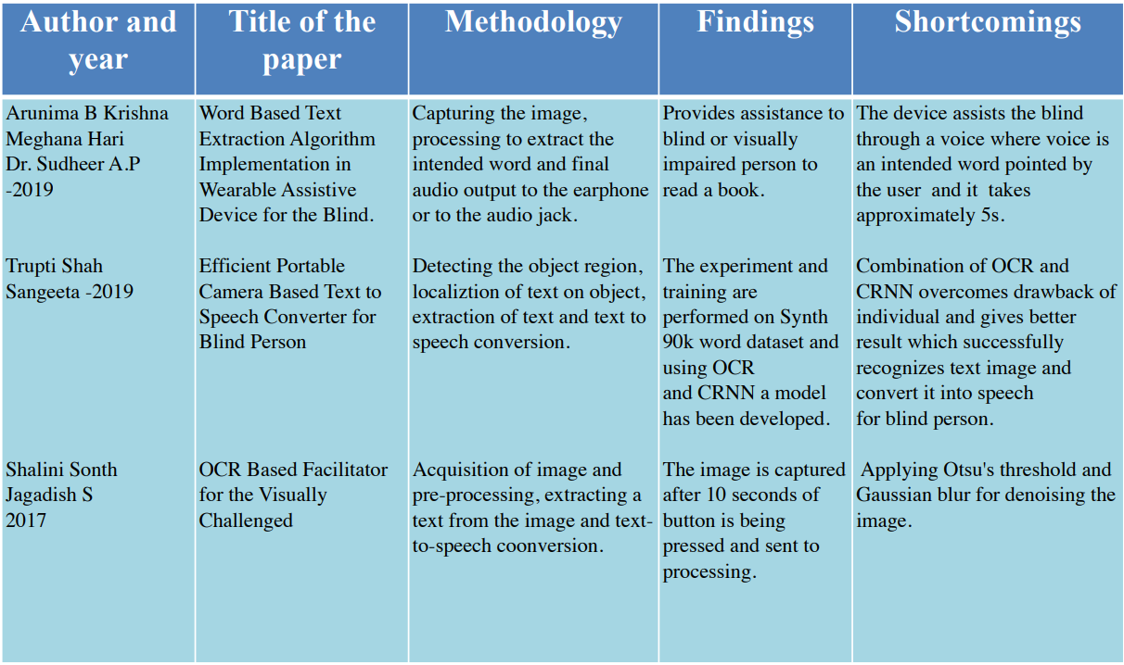
LITERATURE SURVEY

Slide 7
PROBLEM STATEMENT
“Wearable Assistive Device for the Blind Using Word Based Text Extraction Algorithm ”

Slide 8
OBJECTIVES
The objectives of the proposed work is to :
To Detect the ambient light condition.
To detect whether the text is upright.
Image to text conversion, then the extracted text is converted to speech.

Slide 9
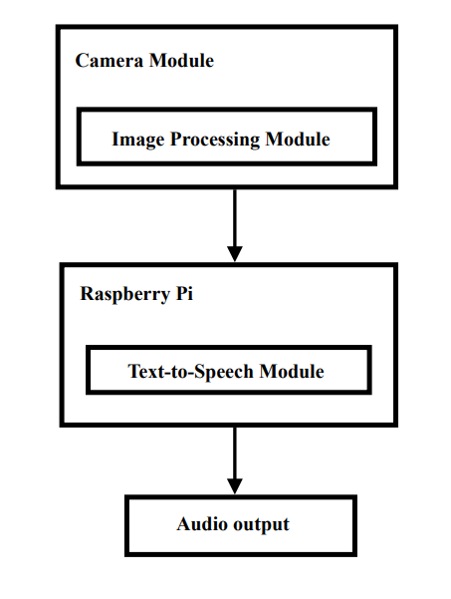
METHODOLOGY
Fig.1: Basic Structure of the Device

Slide 10
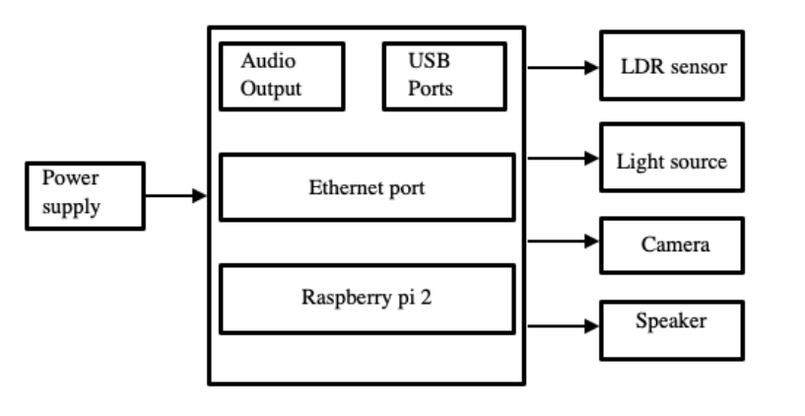

METHODOLOGY
Fig.2: System hardware design

Slide 11
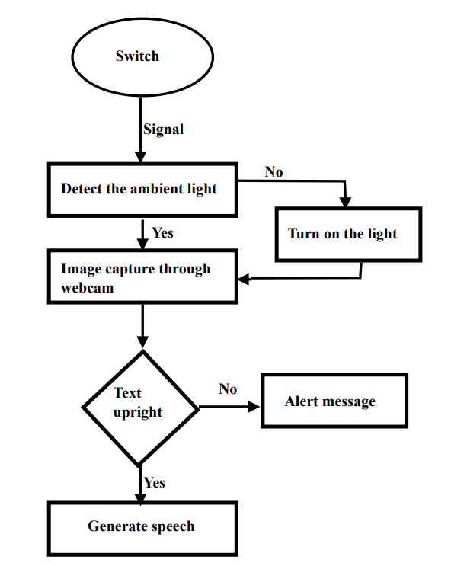
METHODOLOGY
Fig.3: Architecture of the Device

Slide 12
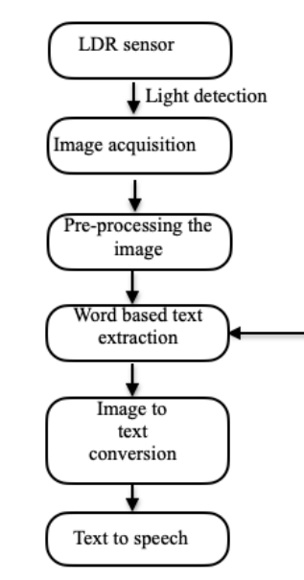

METHODOLOGY
Fig.4: Processing Flow Chart

Slide 13
METHODOLOGY
Text-To-Speech (TTS) Software
Optical Character Recognition (OCR) Software
Camera Module
Audio Output
Wearable Design
Battery Life
User Interface
Accessibility Features
Wireless Connectivity
Open-Source Software

Slide 14
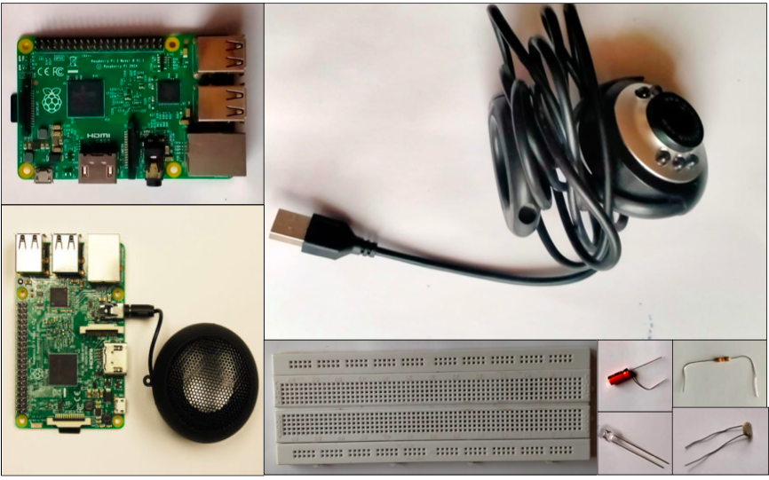
HARDWARE COMPONENTS
Fig.5 Components used

Slide 15
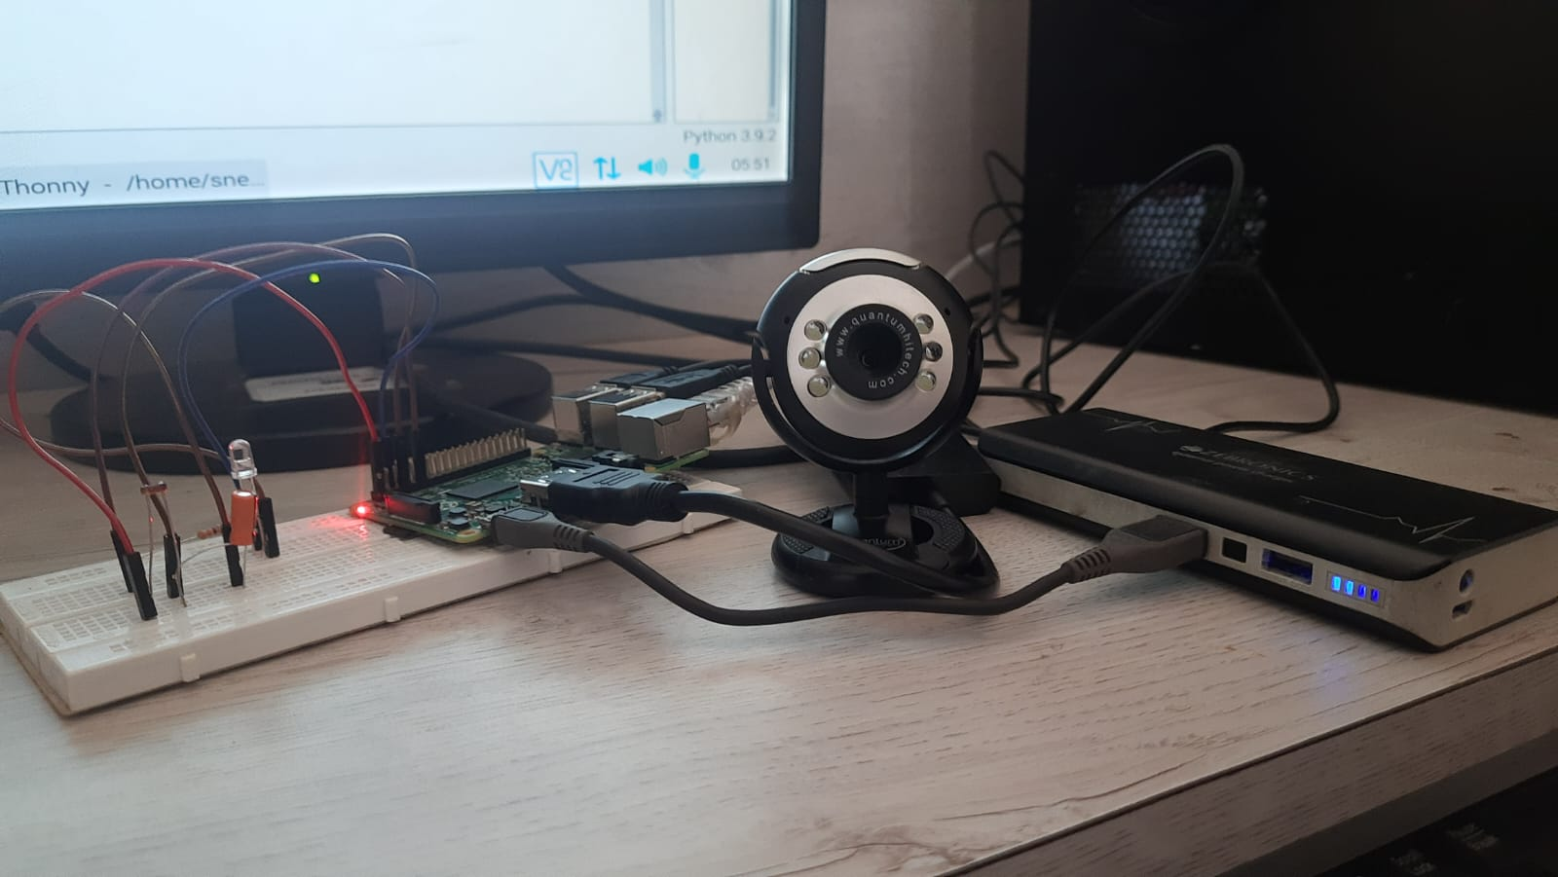
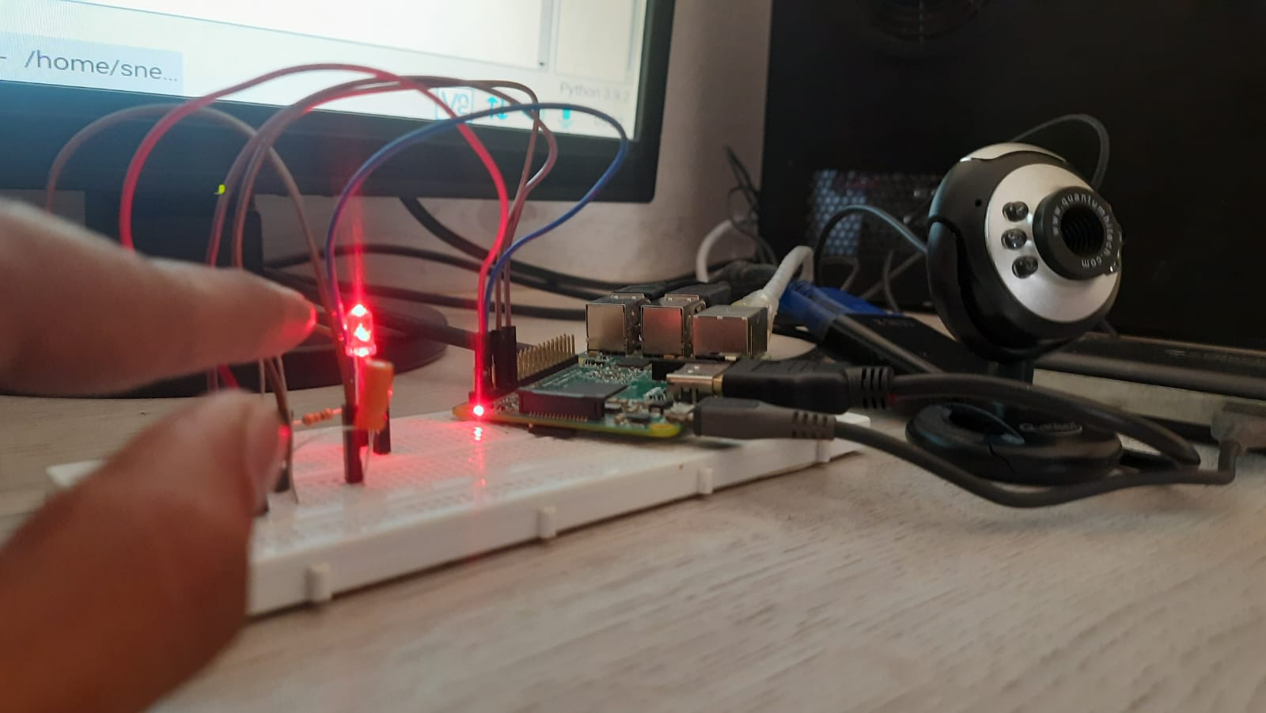
results
Fig.6&7 Behaviour in different light condition

Slide 16
CONCLUSION
The proposed wearable assistive device provides simple and effective assistance to the visually impaired by aiding them to read any text available with them using an efficient algorithm. The model possesses various advantages such as
portability, computational effectiveness and affordability when compared to the other existing technologies. Despite this,various shortcomings of this technology includes the requirement of sensitivity to varying lighting conditions

Slide 17
REFERENCES
[1] | Visual impairment and blindness 2010," 2013. [Online]. Available: http:// www.who.int/blindness/data_maps/
[2] | Trupti Shah and Sangeeta Parshionikar :Efficient Portable Camera Based Text to Speech Converter for Blind Person.
[3] | Arunima B Krishna, Meghana Hari and Dr. Sudheer A.P : Word Based Text Extraction Algorithm Implementation in Wearable Assistive Device for the Blind.
[4] | Shalini Sonth and Jagadish S. Kallimani : OCR based facilitator for the visually challenged.

Slide 18
THANK YOU

